Slide 1
Team #7 Kimchi Up
Red Light Running
Jideok Park, Hyein Seo, Sujeong Lee,
Kevin Saligoe, Quingyuan Hu

Slide 2
Table of Contents
PART 1 Project
Description
PART 2 Project Detail
PART 3 Experiments
PART 4 Conclusion

Slide 3
01
Project Description

Slide 4


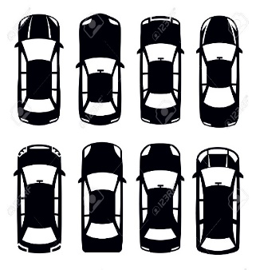
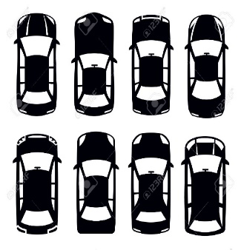
01Project description
Red Light Running
?
A behavior that drivers run through the red light even though the regulations
indicate that driers must stop their vehicles as soon as the traffic light turns red
Stop Line
Stop Line
Case 1
Case 2

Slide 5
PART 01
02
Project Detail

Slide 6

02Project Detail
System Diagram
Bluetooth
LED
Servo motor
Lidar
Radar

Slide 7
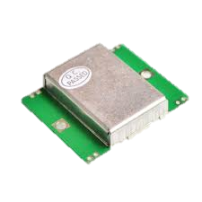
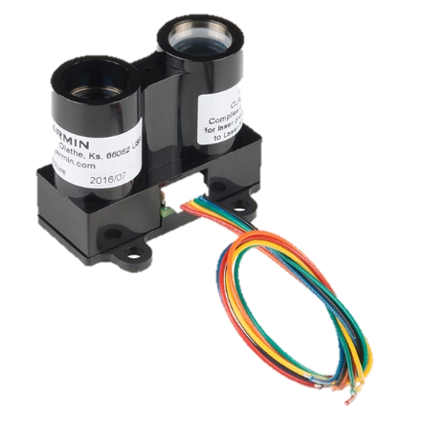
02Project Detail
Sensors used in study
LIDAR Lite v3
HB 100 Radar Module
Range : 40 m (131 ft)
Range : 1~25 m
Wide : 78°
Accuracy < 5m : ±2.5 cm (1 in.)
Accuracy ≥ 5m : ±10 cm (3.9 in.)

Slide 8
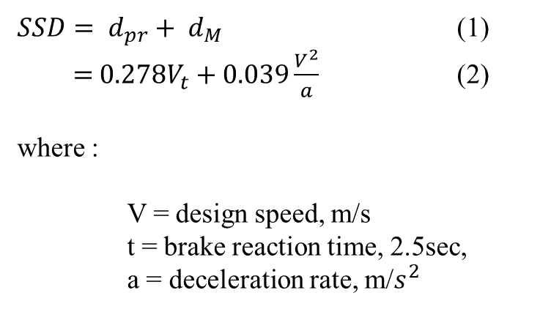
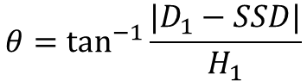
02Project Detail
Stopping Sight Distance (SSD)
$SSD= d_{pr}+ d_{M}$ (1)
$=$ $0.278V_{t}+0.039\frac{V^{2}}{a}$ (2)
where :
V = design speed, m/s
t = brake reaction time, 2.5sec,
a = deceleration rate, m/$s^{2}$
Stopping distance
Reaction distance
Braking distance
Hazard
detected
Braking
begins
The car
stands still
$$θ=\tan^{−1}{⁡\frac{|D_{1}−SSD|}{H_{1}}}$$

Slide 9
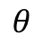
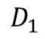
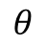
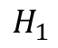
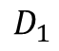
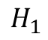
02Project Detail
Stopping Sight Distance (SSD)
Laser pointer
Laser pointer
$$θ$$
$$H_{1}$$
$$θ$$
$$H_{1}$$
RLR car
RLR car
$$D_{1}$$
$$D_{1}$$

Slide 10
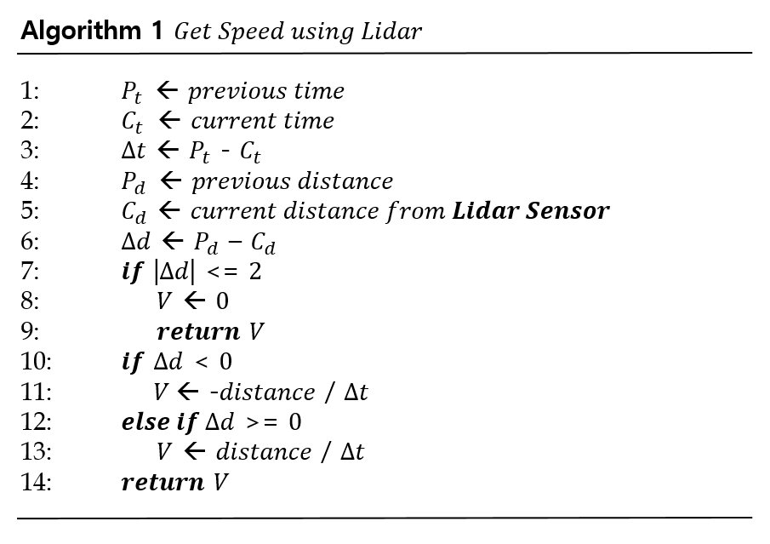
02Project Detail
Algorithm
Notes:
This algorithm is to get speed using lidar.
Whenever the distance value is measured by the Lidar sensor, the speed is calculated by the distance and the time.

Slide 11
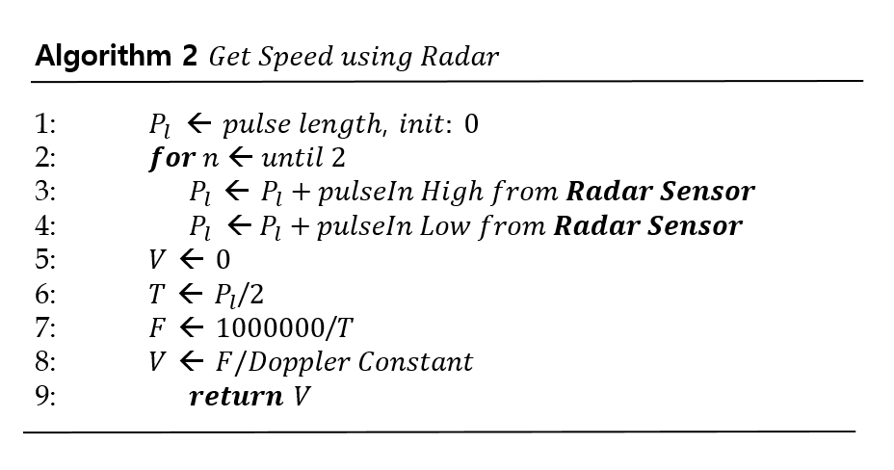
02Project Detail
Algorithm
Notes:
Algorithm2 describes the procedure of getting speed using radar.
By adding the value of pulse from 2 to Pl,
Speed is measured by frequency divided by Doppler constant

Slide 12
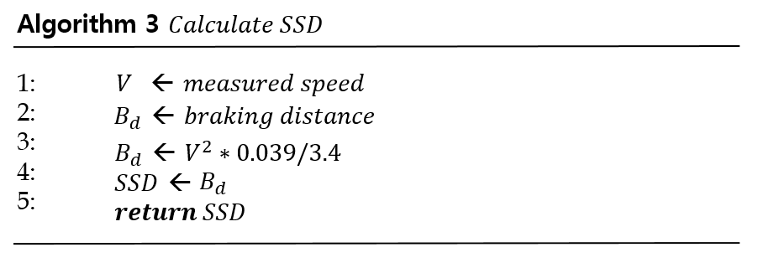
02Project Detail
Algorithm
Notes:
Algorithm 3 is the procedure of calculating Stopping Sight Distance.
It is the process of substituting measured value for the aforementioned SSD formula

Slide 13
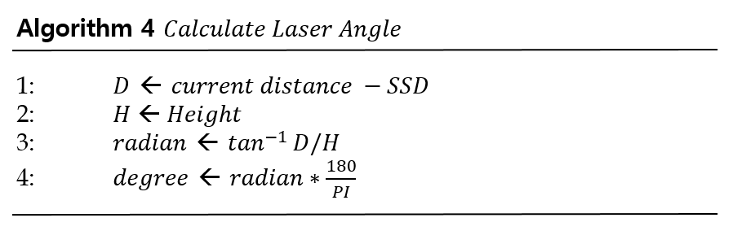
02Project Detail
Algorithm
Notes:
Algorithm 4 describes the procedure of calculating angle for turning laser sensor.
For this process, we can get a degree to move laser sensor.

Slide 14
PART 01
03
Experiments

Slide 15
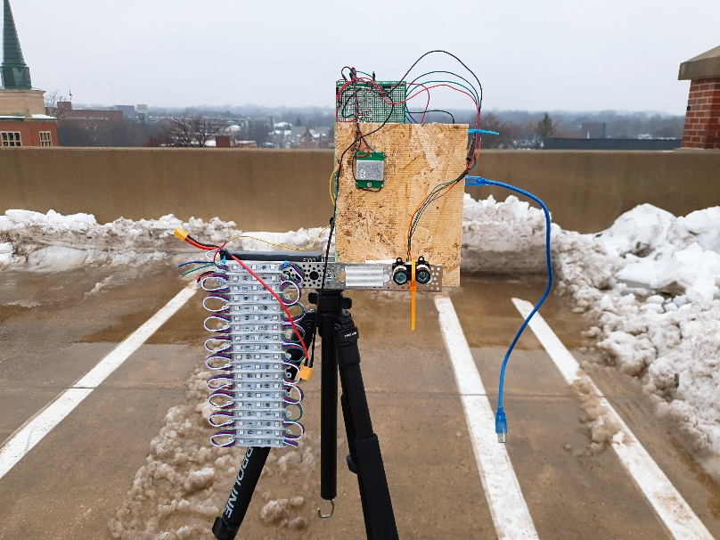
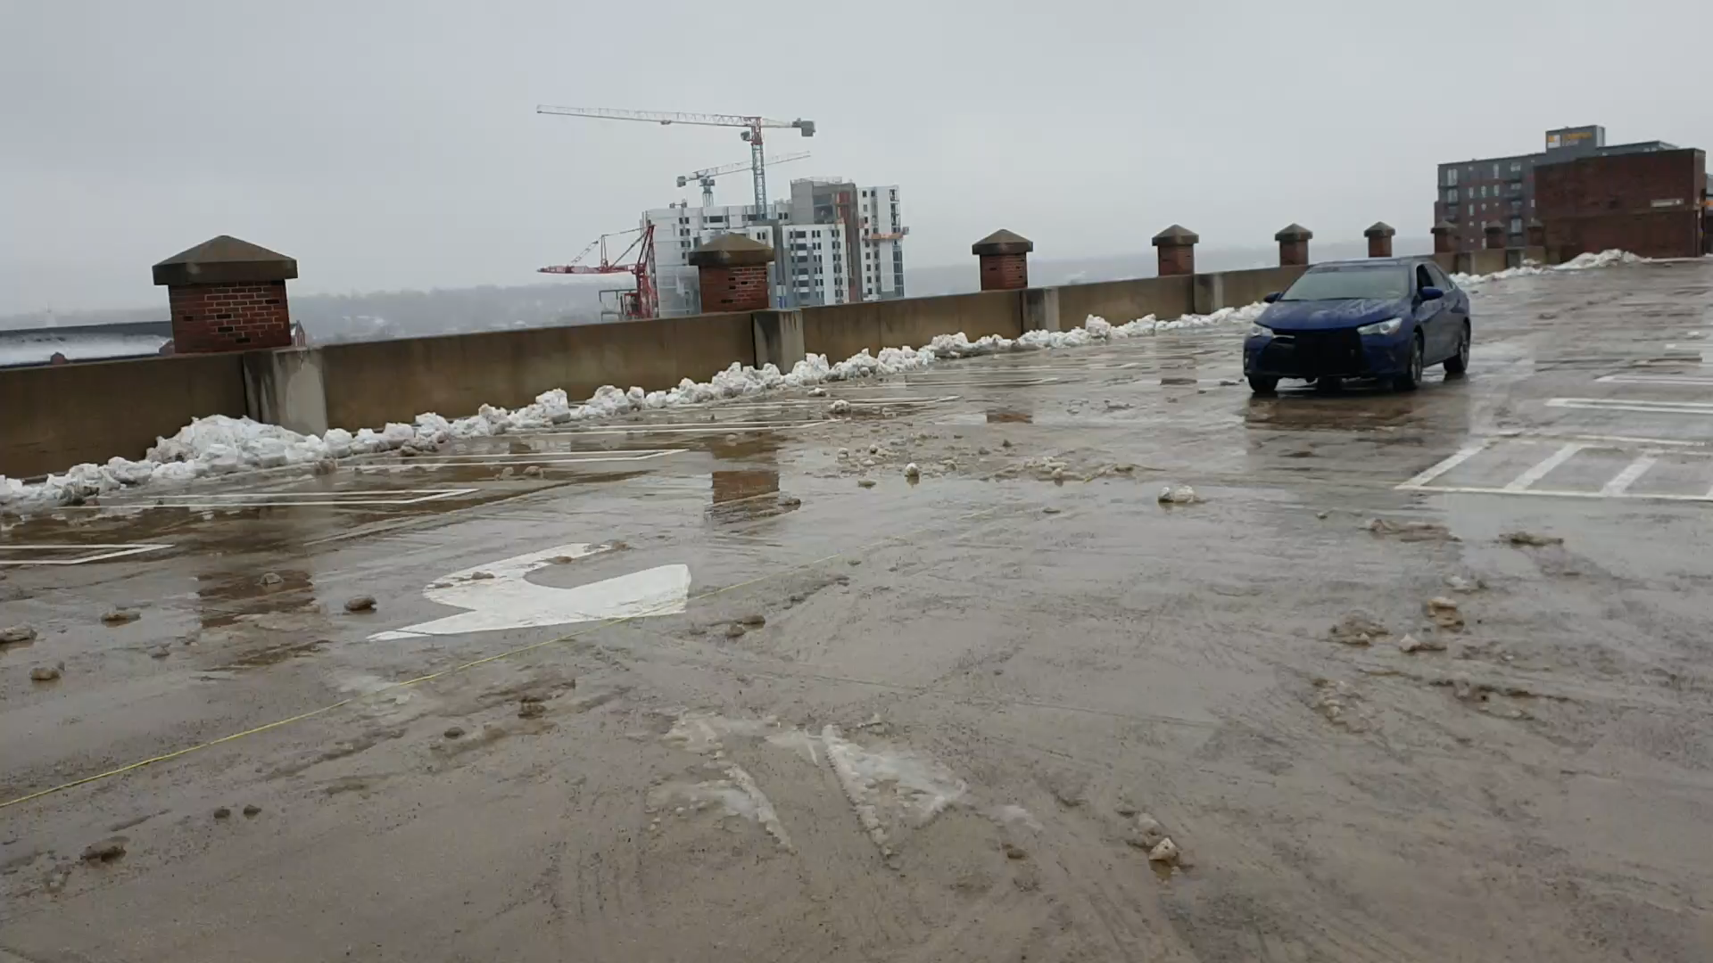
03Experiments

Slide 16
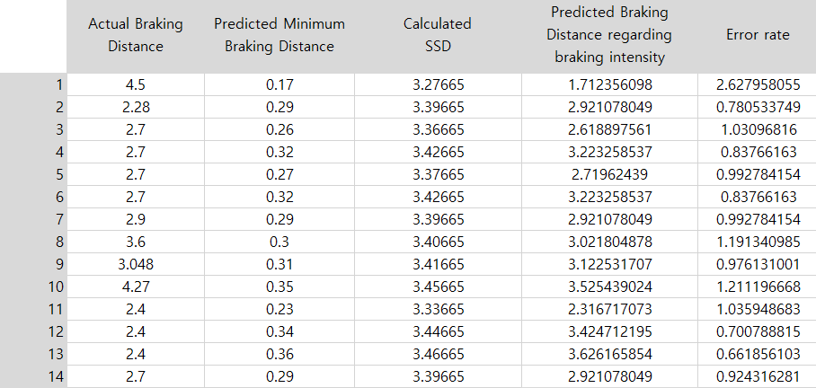
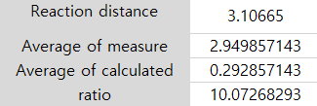
03Experiments

Slide 17
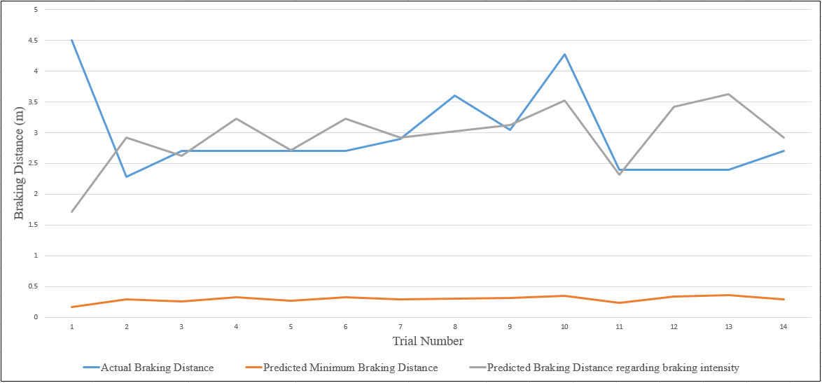
03Experiments
Braking Distance Graph

Slide 18
04
Conclusion

Slide 19

04 Conclusion
To solve Red Light Running

Slide 20
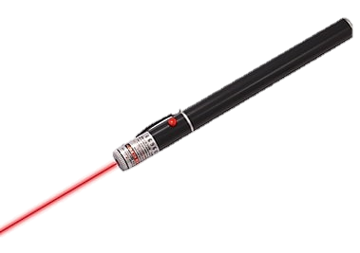
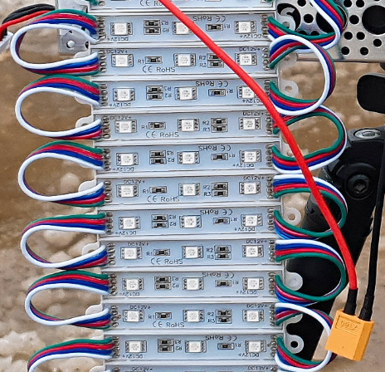
04 Conclusion
A warning system to inform Non-RLR drivers that GS RLR vehicle is coming
Laser pointer
LED

Slide 21

04 Conclusion
To stabilize the system …
Noise canceling circuit is needed.
Lidar and Radar sensors are executed when in front of the vehicle.

Slide 22
Thank you
Q&A

